Slide 1
Question 1: Systematic AI Fund
Liam Andrew Beattie - 22562435

Slide 2
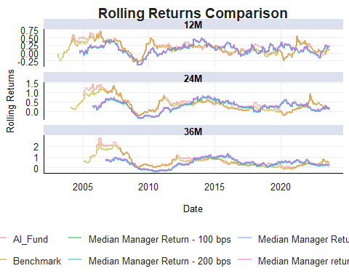
Purpose
Purpose of this work folder.
Ideally store a minimum working example data set in data folder.
Add binary files in bin, and closed R functions in code. Human Readable settings files (e.g. csv) should be placed in settings/
get_median_manager_data <- function(data, start_date, end_date) { median_manager <- filter_active_managers(data, start_date, end_date) %>% identify_median_manager() data %>% filter(Fund == median_manager) } get_fee_adjusted_returns <- function(data, returns_column, fee_levels) { calculate_fee_adjusted_returns(data, returns_column, fee_levels) %>% select(date, Type, Rets) %>% mutate(Type = paste0("Median Manager ", Type)) } calculate_rolling_returns_by_type <- function(data, rolling_windows) { calculate_all_rolling_returns_for_fees(data, rolling_windows) } combine_rolling_returns <- function(ai_data, bm_data, fee_data, rolling_windows) { ai_rolling <- calculate_all_rolling_returns(ai_data$AI_Fund, ai_data$date, rolling_windows, "AI_Fund") bm_rolling <- calculate_all_rolling_returns(bm_data$Returns, bm_data$date, rolling_windows, "Benchmark") fee_rolling <- calculate_rolling_returns_by_type(fee_data, rolling_windows) bind_rows(ai_rolling, bm_rolling, fee_rolling) }
plot_rolling_returns <- function(data) { ggplot(data %>% filter(!is.na(rolling_return)), aes(x = date, y = rolling_return, color = Type)) + geom_line(linewidth = 1, alpha = 0.5) + facet_wrap(~ Period, ncol = 1, scales = "free_y") + labs( title = "Rolling Returns Comparison", x = "Date", y = "Rolling Returns", color = "Type" ) + fmxdat::theme_fmx() + theme( plot.title = element_text(hjust = 0.5), legend.position = "bottom" ) }
plot_density <- function(data) { ggplot(data %>% filter(!is.na(rolling_return)), aes(x = rolling_return, fill = Type)) + geom_density(alpha = 0.6) + facet_wrap(~ Period, scales = "free") + labs( title = "Density of Rolling Returns by Period", x = "Rolling Return", y = "Density", fill = "Type" ) + theme_bw() + theme( plot.title = element_text(hjust = 0.5), legend.position = "bottom" ) }
plot_returns_by_volatility <- function(data) { ggplot(data %>% filter(!is.na(Volatility_Regime) & Period == "12M" & !is.na(rolling_return)), aes(x = rolling_return, fill = Type)) + geom_density(alpha = 0.5) + facet_wrap(~ Volatility_Regime + Period, scales = "free_y") + labs( title = "Rolling Returns by Volatility Regime", x = "Rolling Return", y = "Density", fill = "Type" ) + theme_bw() + theme( plot.title = element_text(hjust = 0.5), legend.position = "bottom" ) }
# Step 1: Median Manager Data ASISA_median <- get_median_manager_data(ASISA, "2005-06-01", "2023-08-31") # Step 2: Fee-Adjusted Returns median_manager_fees <- get_fee_adjusted_returns(ASISA_median, "Returns", c(50, 100, 200)) # Step 3: Combined Rolling Returns combined_rolling <- combine_rolling_returns(AI_Fund, BM, median_manager_fees, c(12, 24, 36)) # Step 4: Plots plot_rolling_returns(combined_rolling)

Slide 3
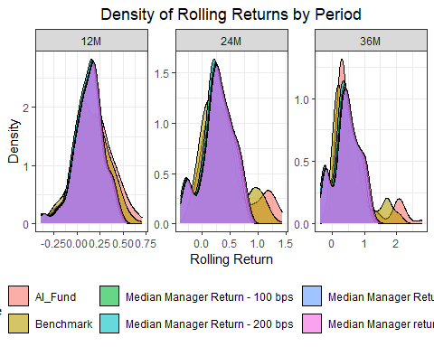
plot_density(combined_rolling)

Slide 4
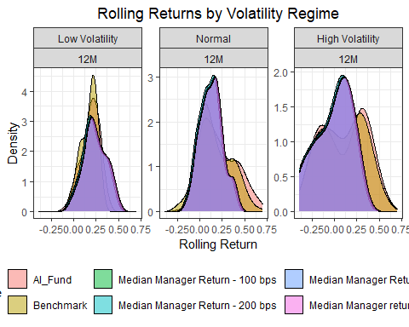
# Step 5: Volatility Analysis BM_volatility <- calculate_rolling_volatility(BM$Returns, BM$date, window_size = 20) %>% mutate(Volatility_Regime = stratify_volatility_regimes(Rolling_Volatility)) combined_with_volatility <- combined_rolling %>% left_join(BM_volatility %>% select(date, Volatility_Regime), by = "date") %>% mutate(Volatility_Regime = factor(Volatility_Regime, levels = c("Low Volatility", "Normal", "High Volatility"))) plot_returns_by_volatility(combined_with_volatility)

Slide 5
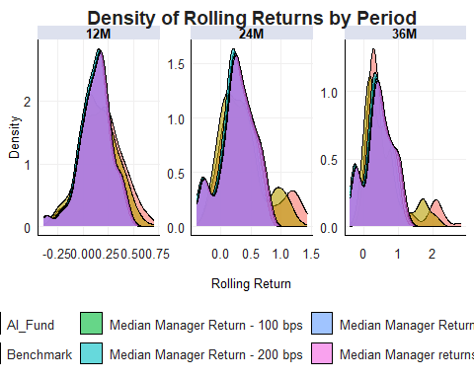
ggplot(combined_rolling %>% filter(!is.na(rolling_return)), aes(x = rolling_return, fill = Type)) + geom_density(alpha = 0.6) + # Semi-transparent density plots facet_wrap(~ Period,scales = "free") + # Facet by rolling period labs( title = "Density of Rolling Returns by Period", x = "Rolling Return", y = "Density", fill = "Type" ) + fmxdat::theme_fmx() + theme( plot.title = element_text(hjust = 0.5), legend.position = "bottom" )

Slide 6
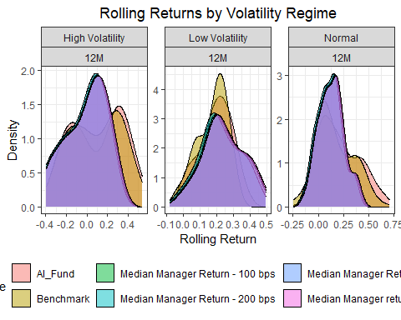
***
# Calculate rolling volatility for the benchmark (BM) BM_volatility <- calculate_rolling_volatility(BM$Returns, BM$date, window_size = 20) %>% mutate(Volatility_Regime = stratify_volatility_regimes(Rolling_Volatility)) # Merge volatility regimes with combined rolling returns combined_rolling_with_volatility <- combined_rolling %>% left_join(BM_volatility %>% select(date, Volatility_Regime), by = "date")
combined_rolling_with_volatility %>% filter(!is.na(Volatility_Regime)&Period=="12M"&(!is.na(rolling_return))) %>% ggplot( aes(x = rolling_return, fill = Type)) + geom_density(alpha = 0.5) + facet_wrap(~ Volatility_Regime+Period,scales = "free" ) + labs( title = "Rolling Returns by Volatility Regime", x = "Rolling Return", y = "Density", fill = "Type" ) + theme_bw() + theme(plot.title = element_text(hjust = 0.5), legend.position = "bottom")

